Slide 1

Chat Application and Website
Task - 2

Slide 2
Chat application and website
The development of this project centered on the development of a message protocol that would allow the application to properly log in users, send messages, and perform system maintenance.
LMS USERNAME | NAME | BATCH
2115a624 | Vijayaraghul.G | A6
2115a625 | Vimal Raj.D | A6
2115a627 | Vishwa.R | A6
2115a614 | Teja.B | A6

Slide 3
Task - 2
Create various Front End Programs
Draw and design a uniform front end code for chat application
Evaluation Metric:
100% Completion of the above tasks
Learning Outcome
Get to know about concepts of project bucketing
Knowing about various frontend development framework like angular, vue,react
Know about various react topics like components, props, state, life cycle etc.

Slide 4
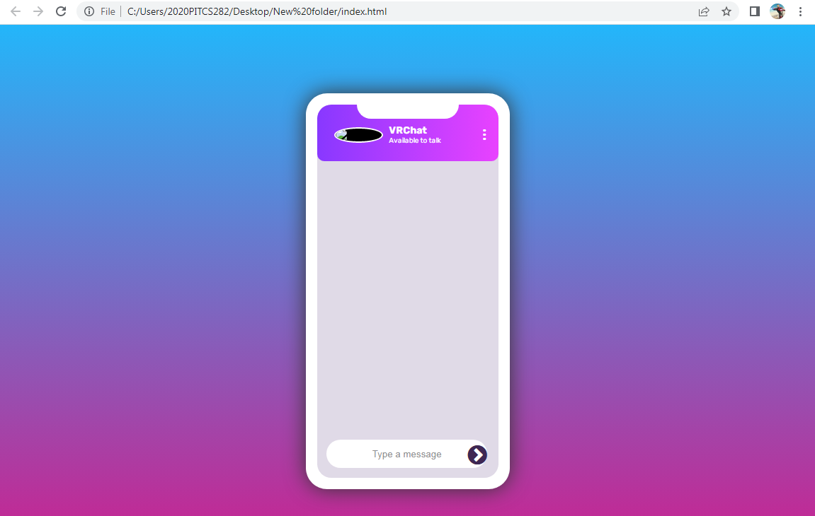
Past chat application output here

Slide 5
CHAT APPLICATION
https://github.com/VimalRaj-12/fullstack

